Slide 1
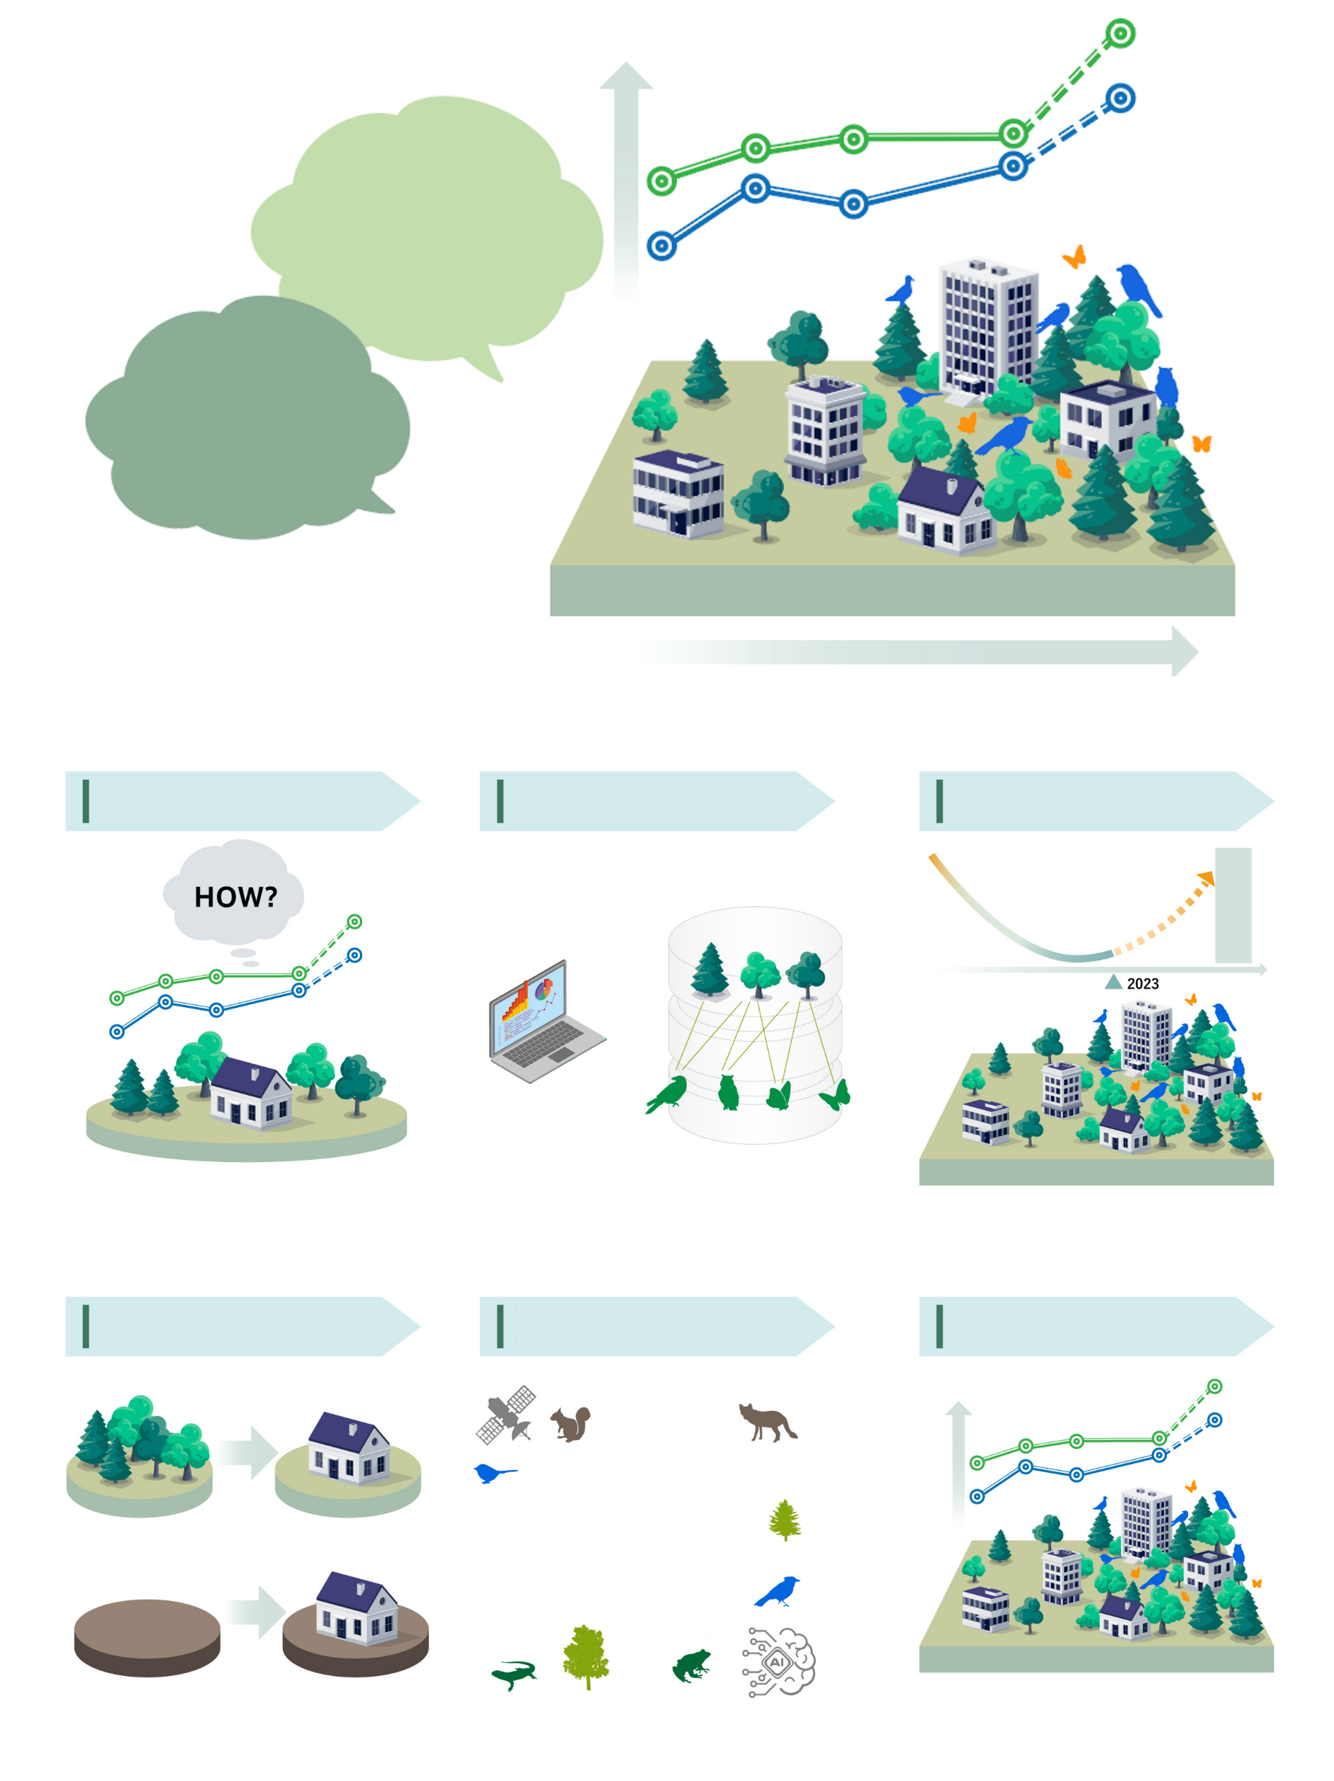

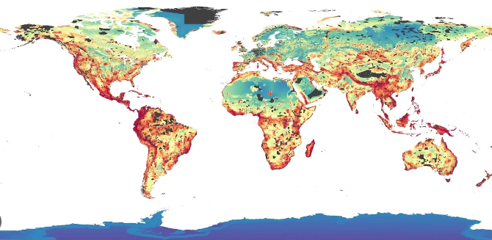
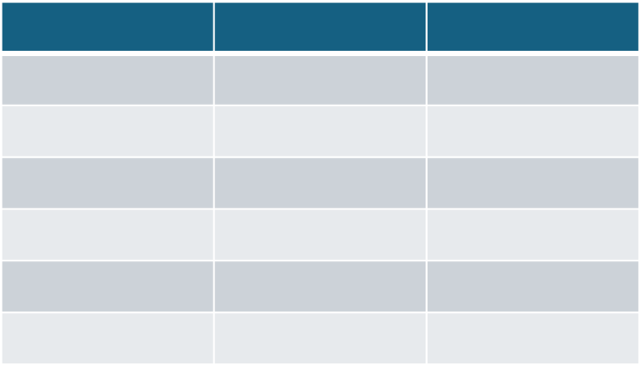
How to quantify net gains produced by green infrastructure?
How can our company conduct natural regeneration based on science?
Needs for regeneration
of nature on residential lots
Calculate restoration potential using species distribution data
Analise land use history in the focus locations
Data on animals using planted trees as habitat
Propose the best species composition for your location
Natural regeneration effects quantified

Slide 2
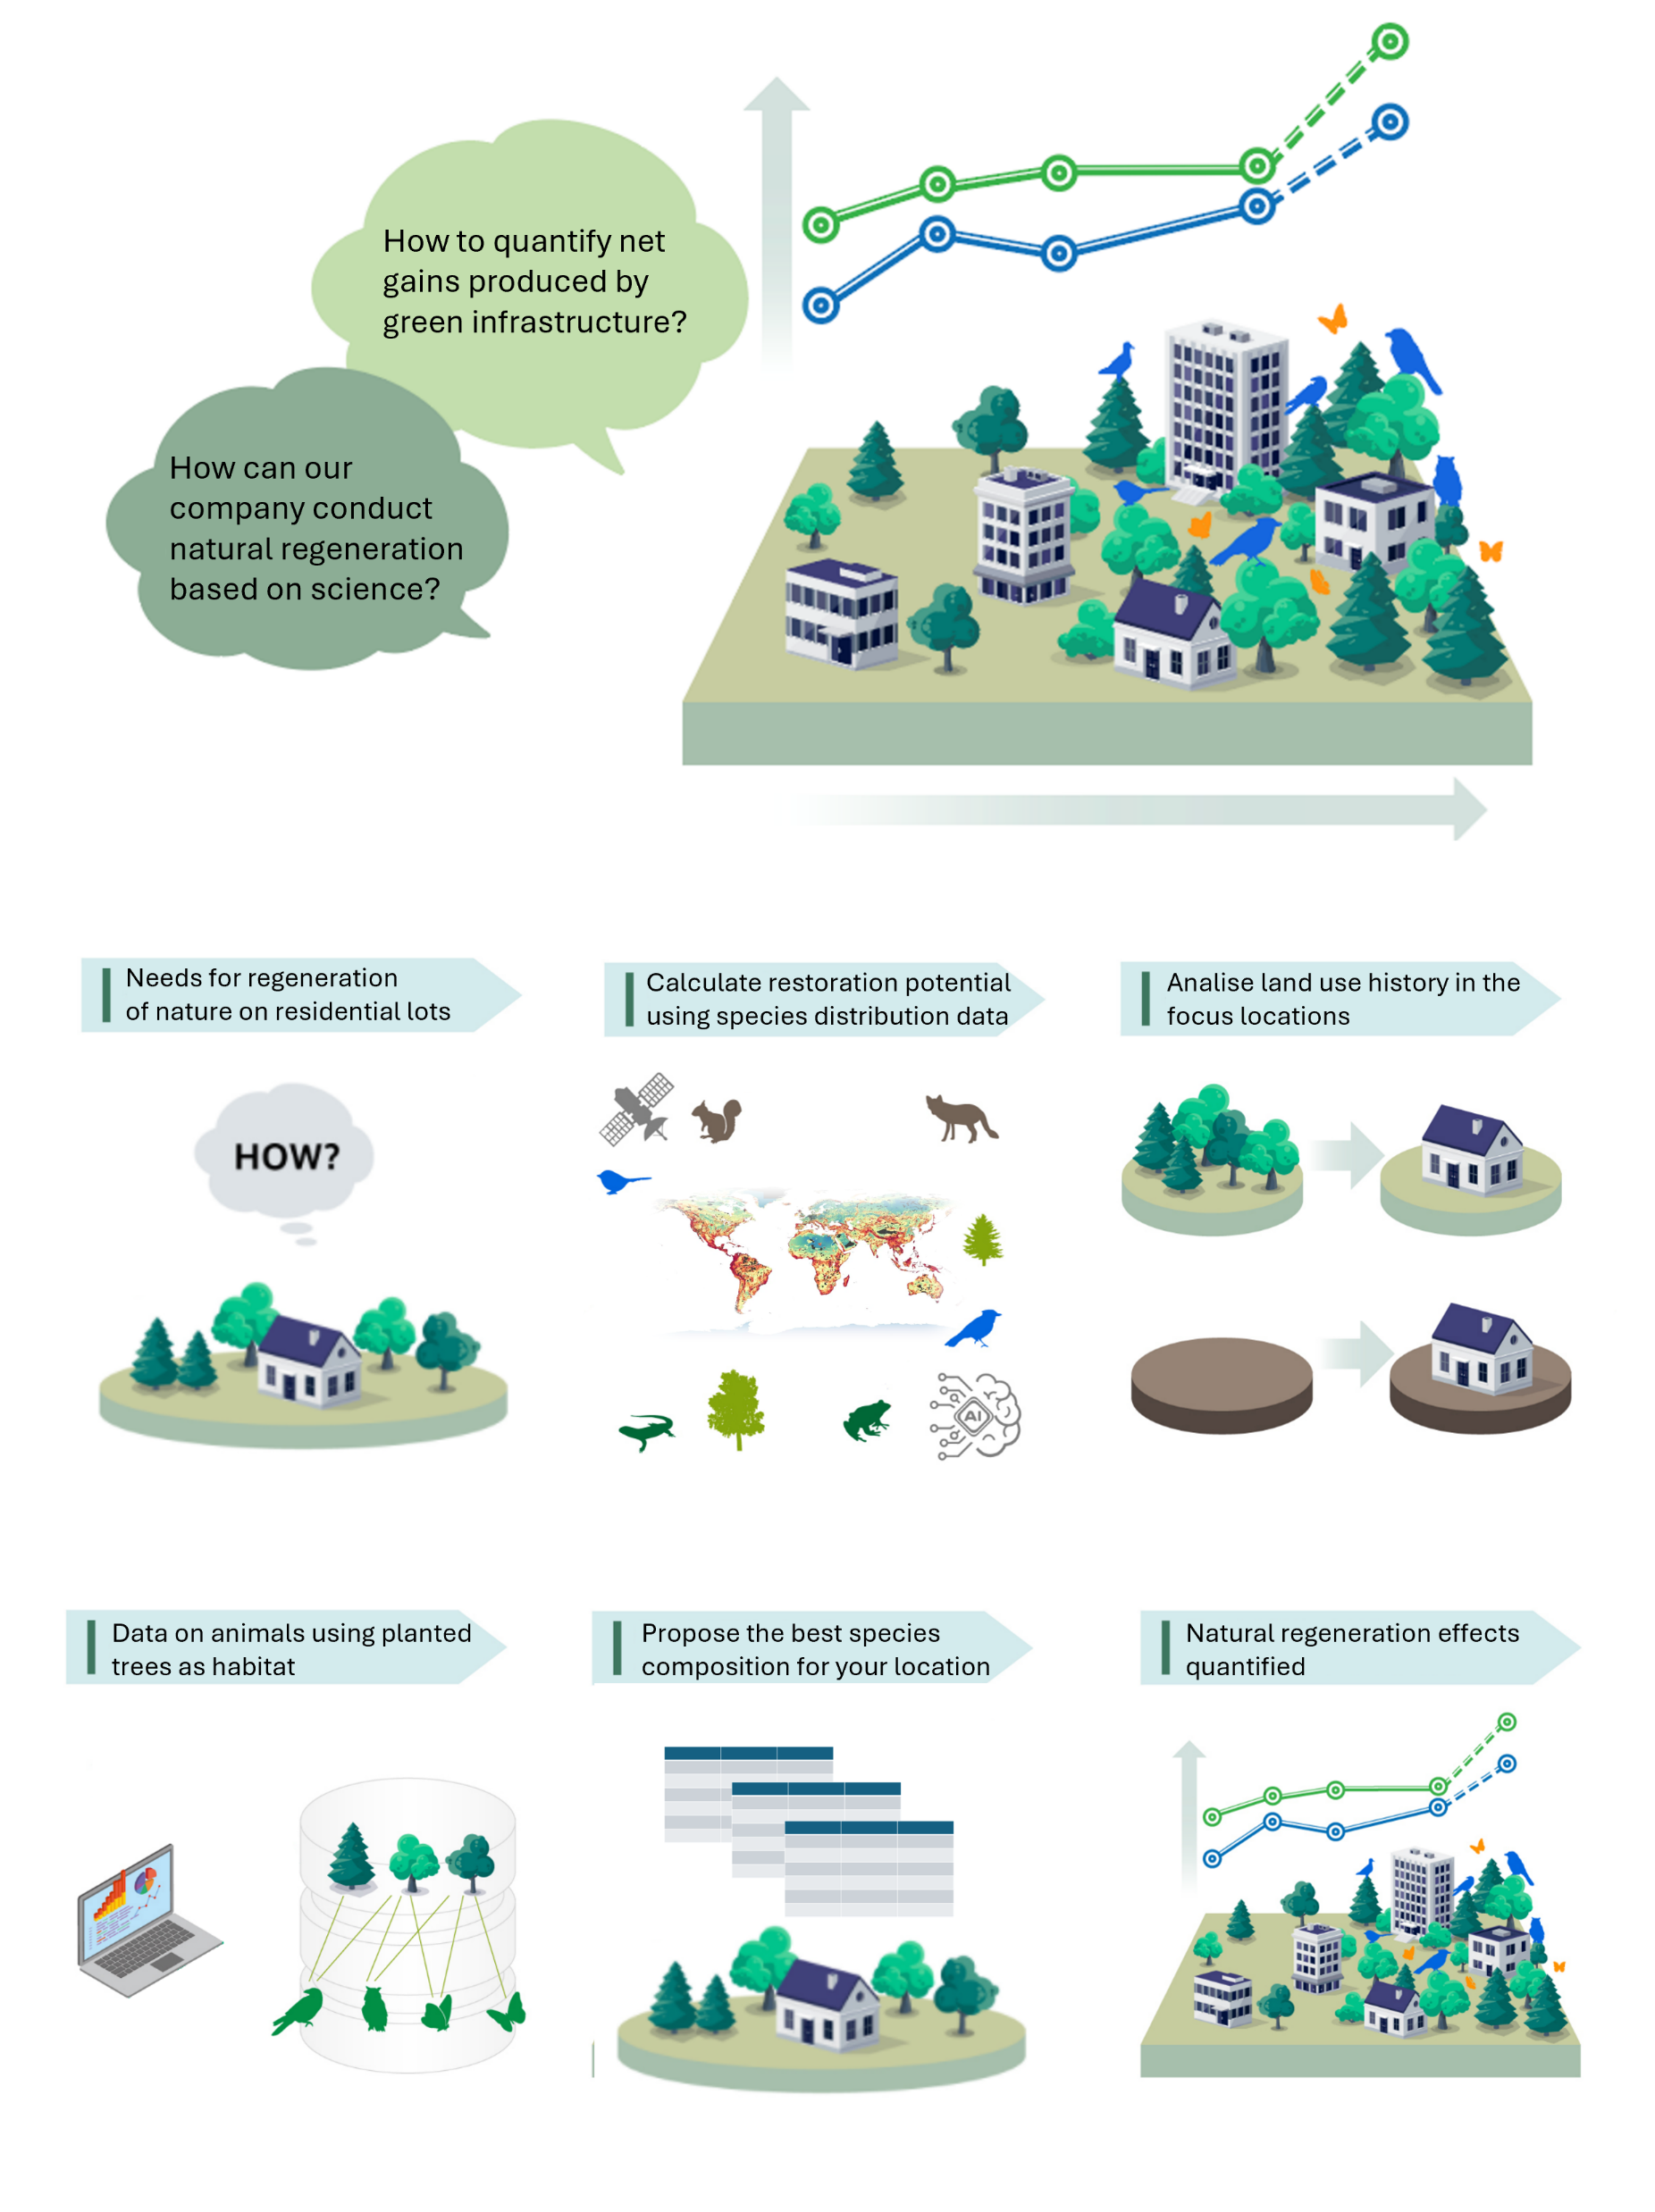



Slide 3
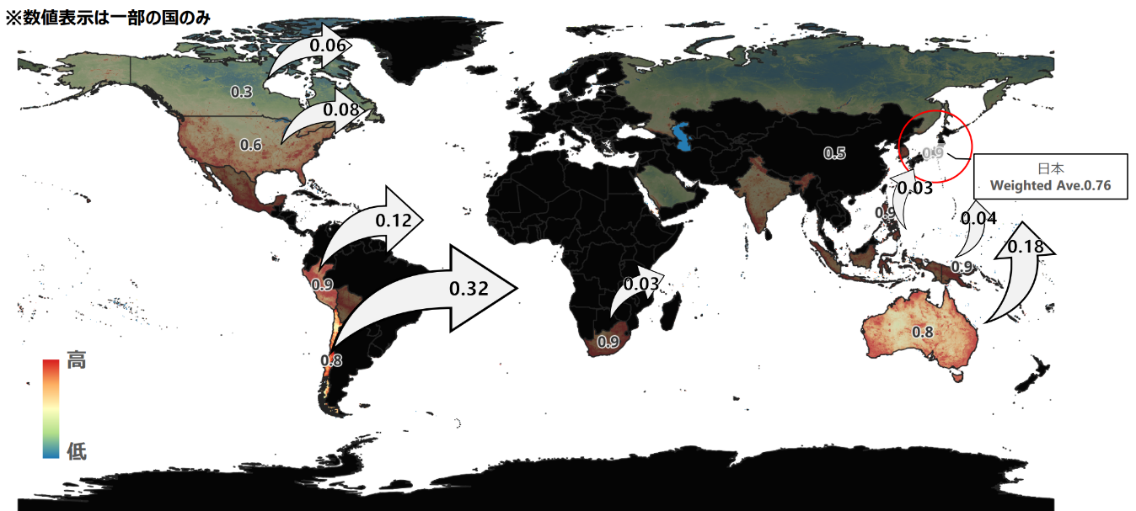

Weighted average of the mining sector's import destination countries overlaid with the biodiversity importance of the sector
Weighted avg.
JPN 0.76
Trade
Flow Rate
High
Biodiversity
Importance
Low

Slide 4
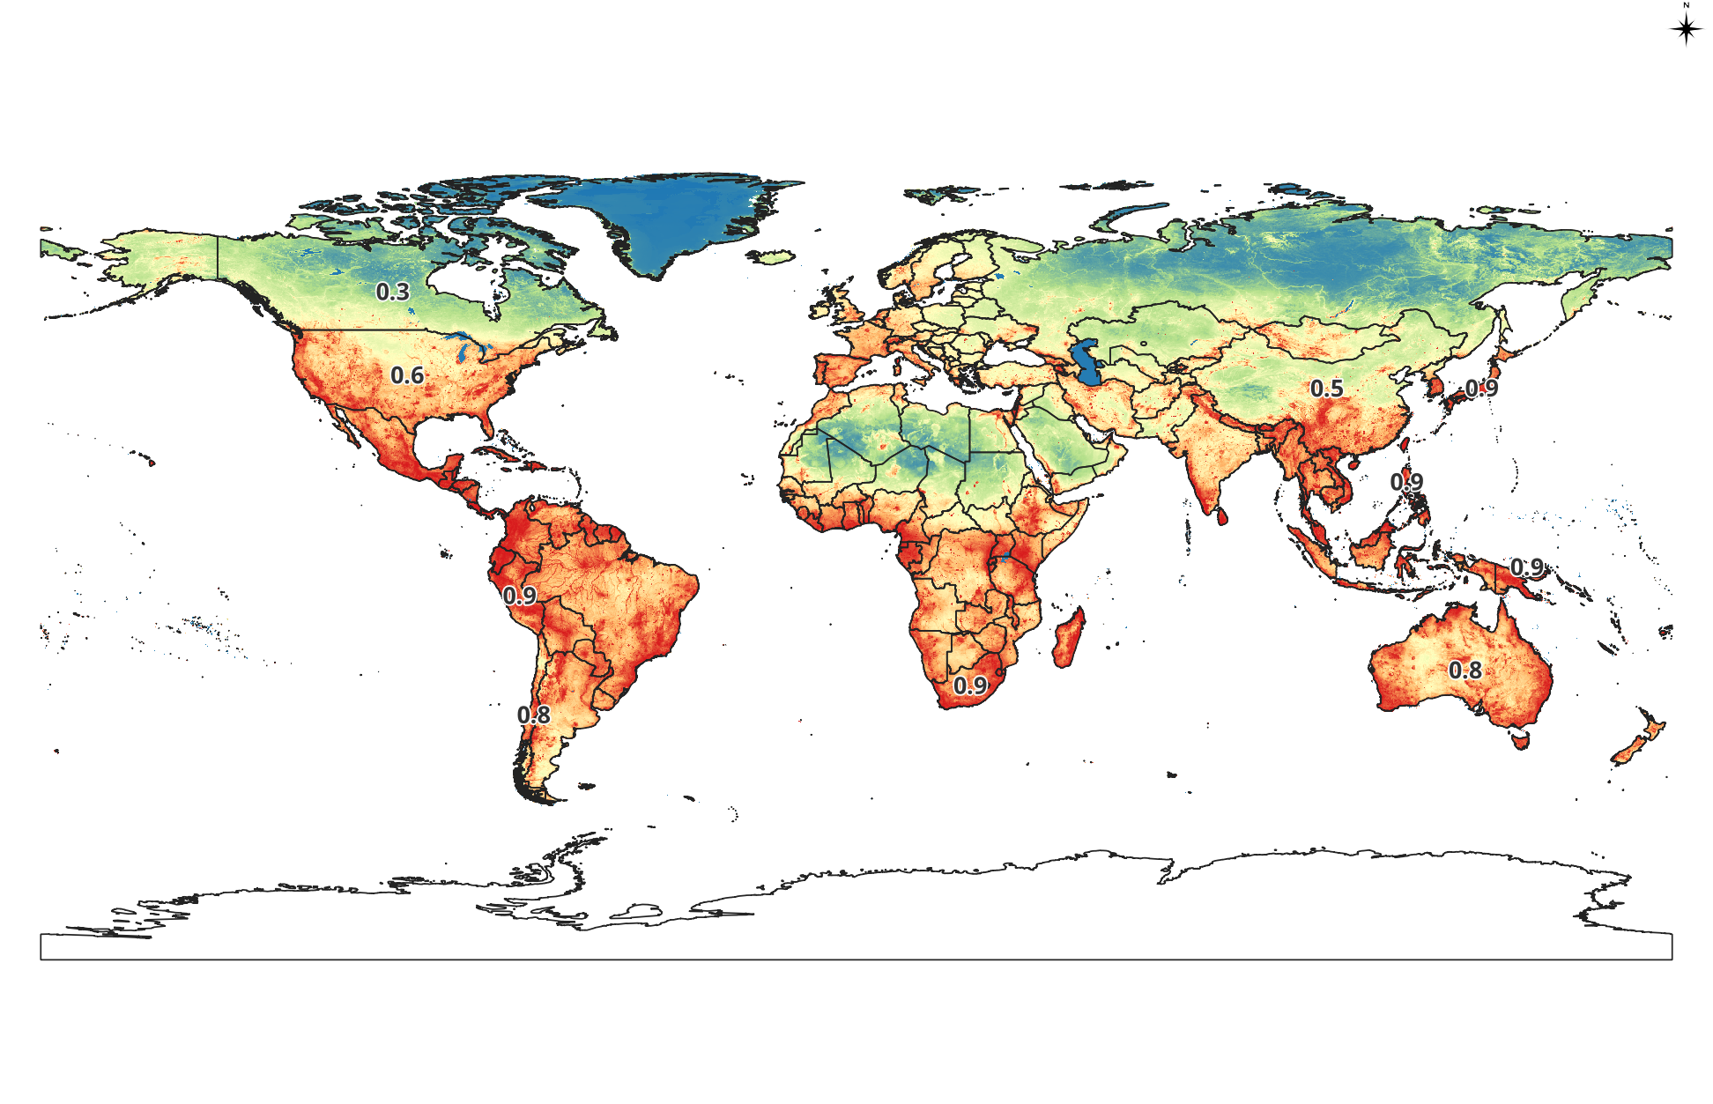
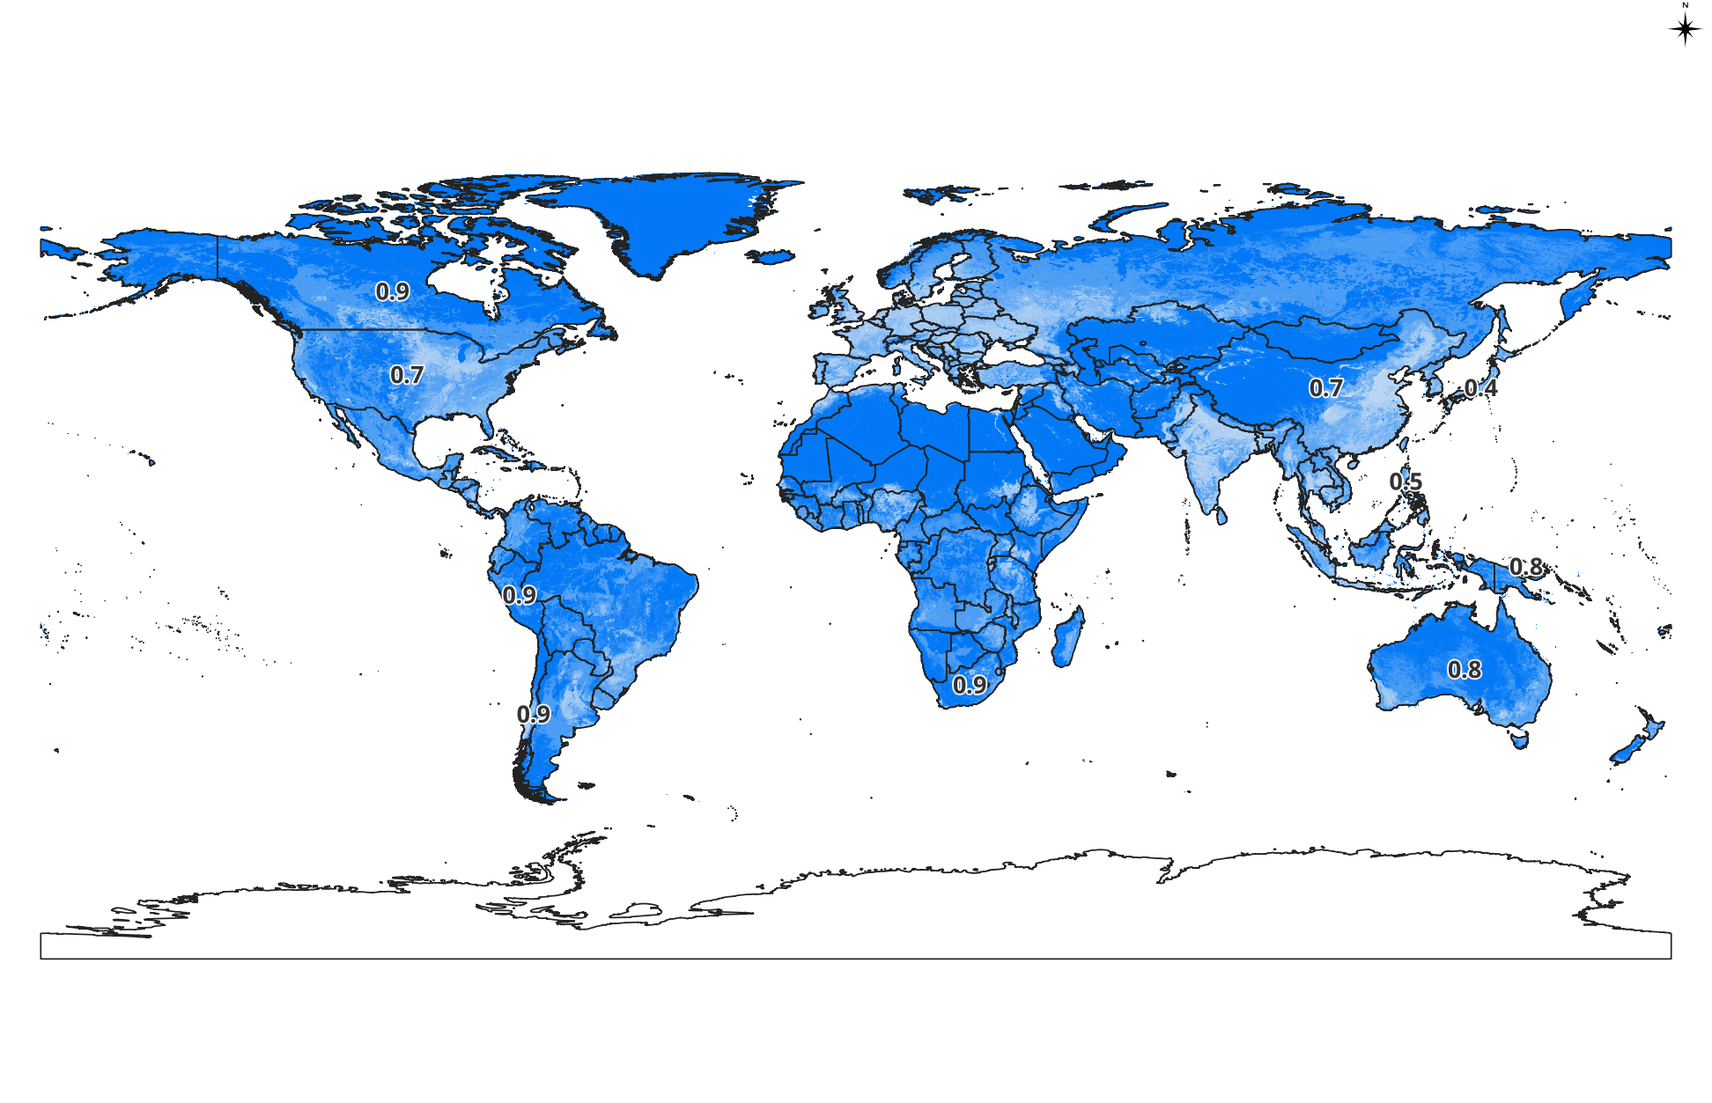
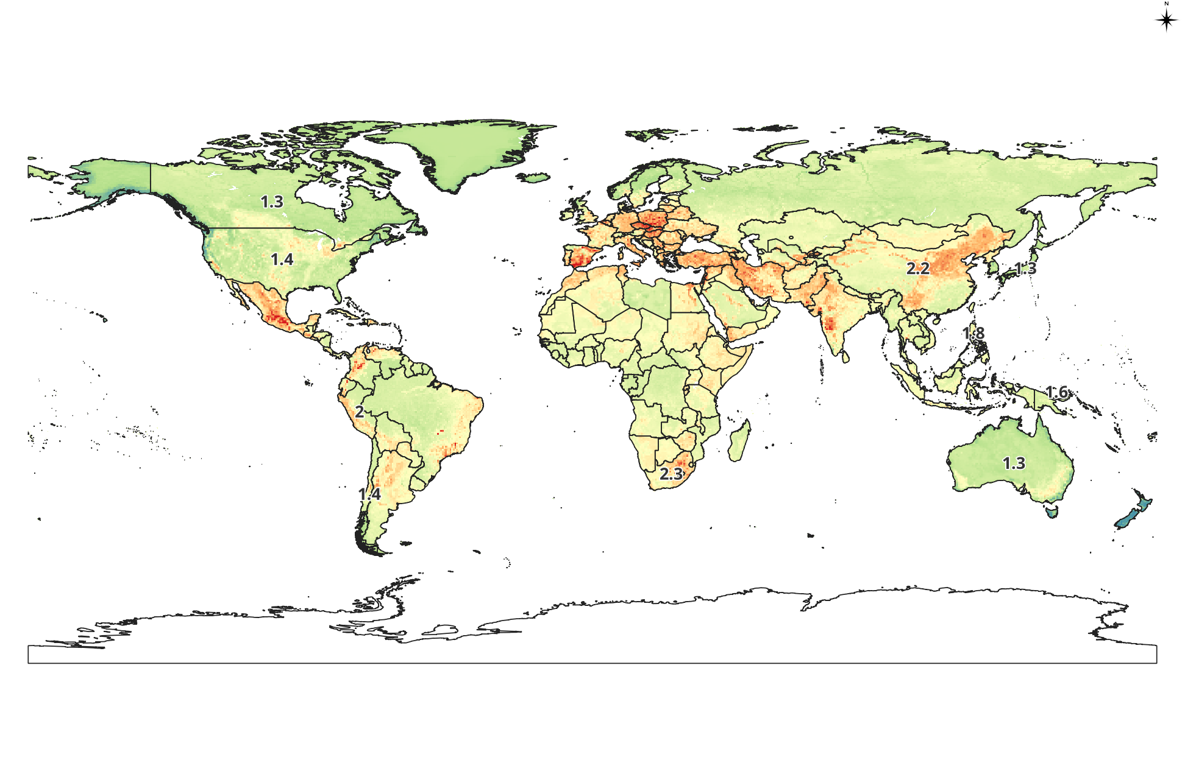
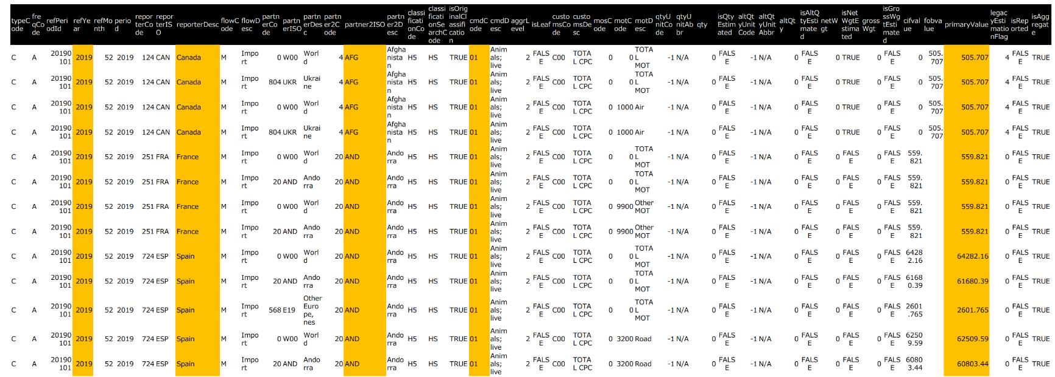
Spatially explicit biodiversity dataset
International
trade dataset by sectors and by countries
https://comtrade.un.org/
Comprehens-ive portfolio analysis
Country-value _{ij}×∑_{ij} PF_at_{ij} / Σ _{ij} PF_ap_{ij}
PF_at_{ij} : Attribution factor
PF_ap_{ij}: Applicable attribution factor

Slide 5
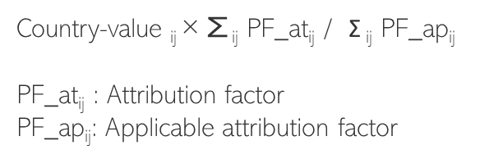
Spatially explicit biodiversity dataset
International
trade dataset by sectors and countries
https://comtrade.un.org/
Comprehensive portfolio analysis

Slide 6
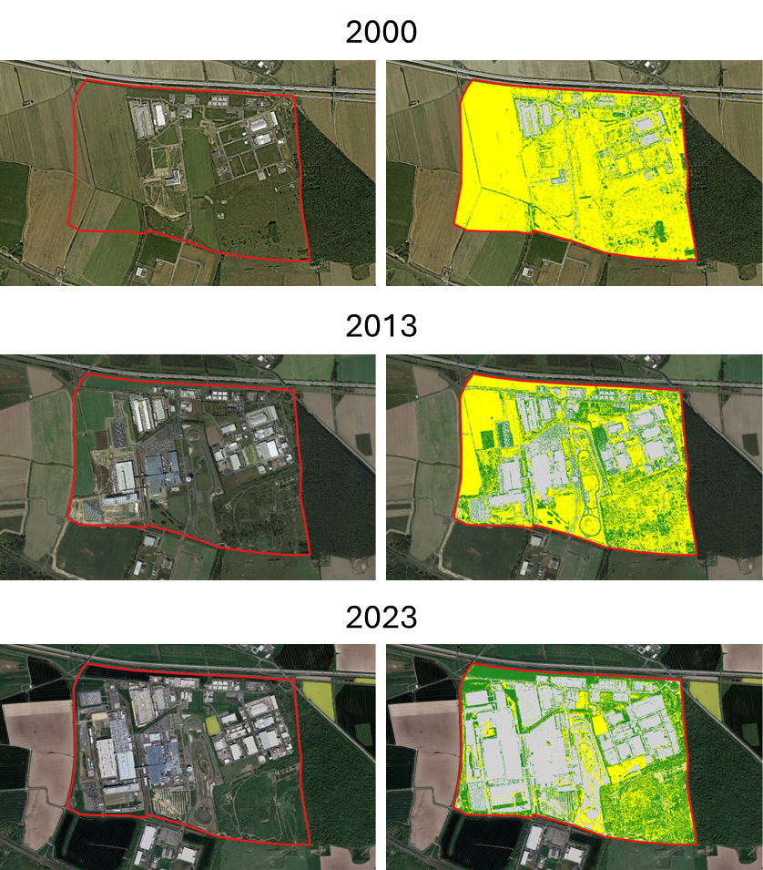
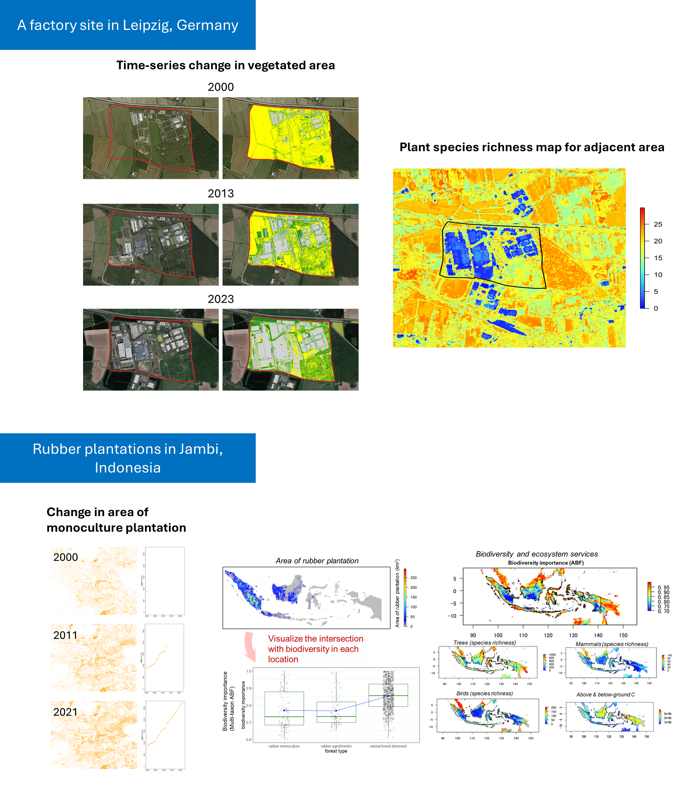
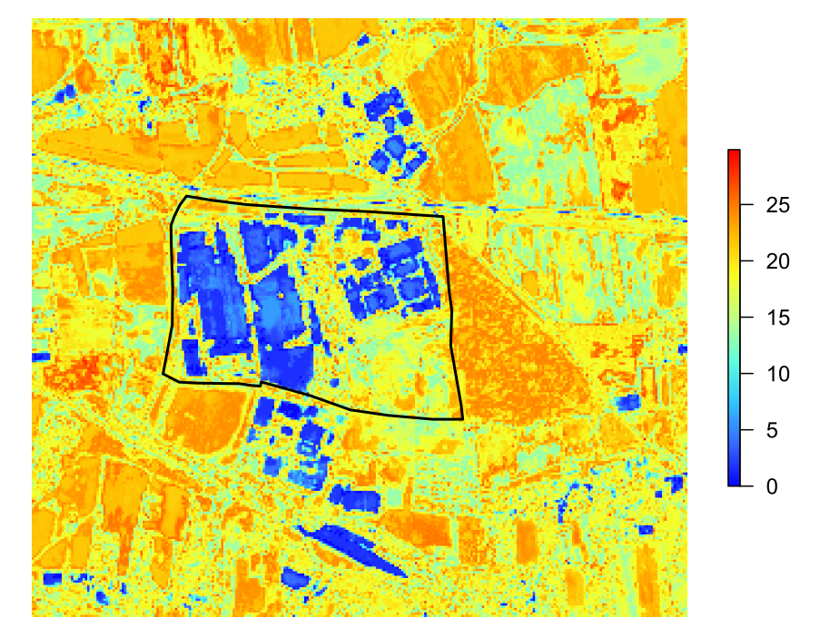
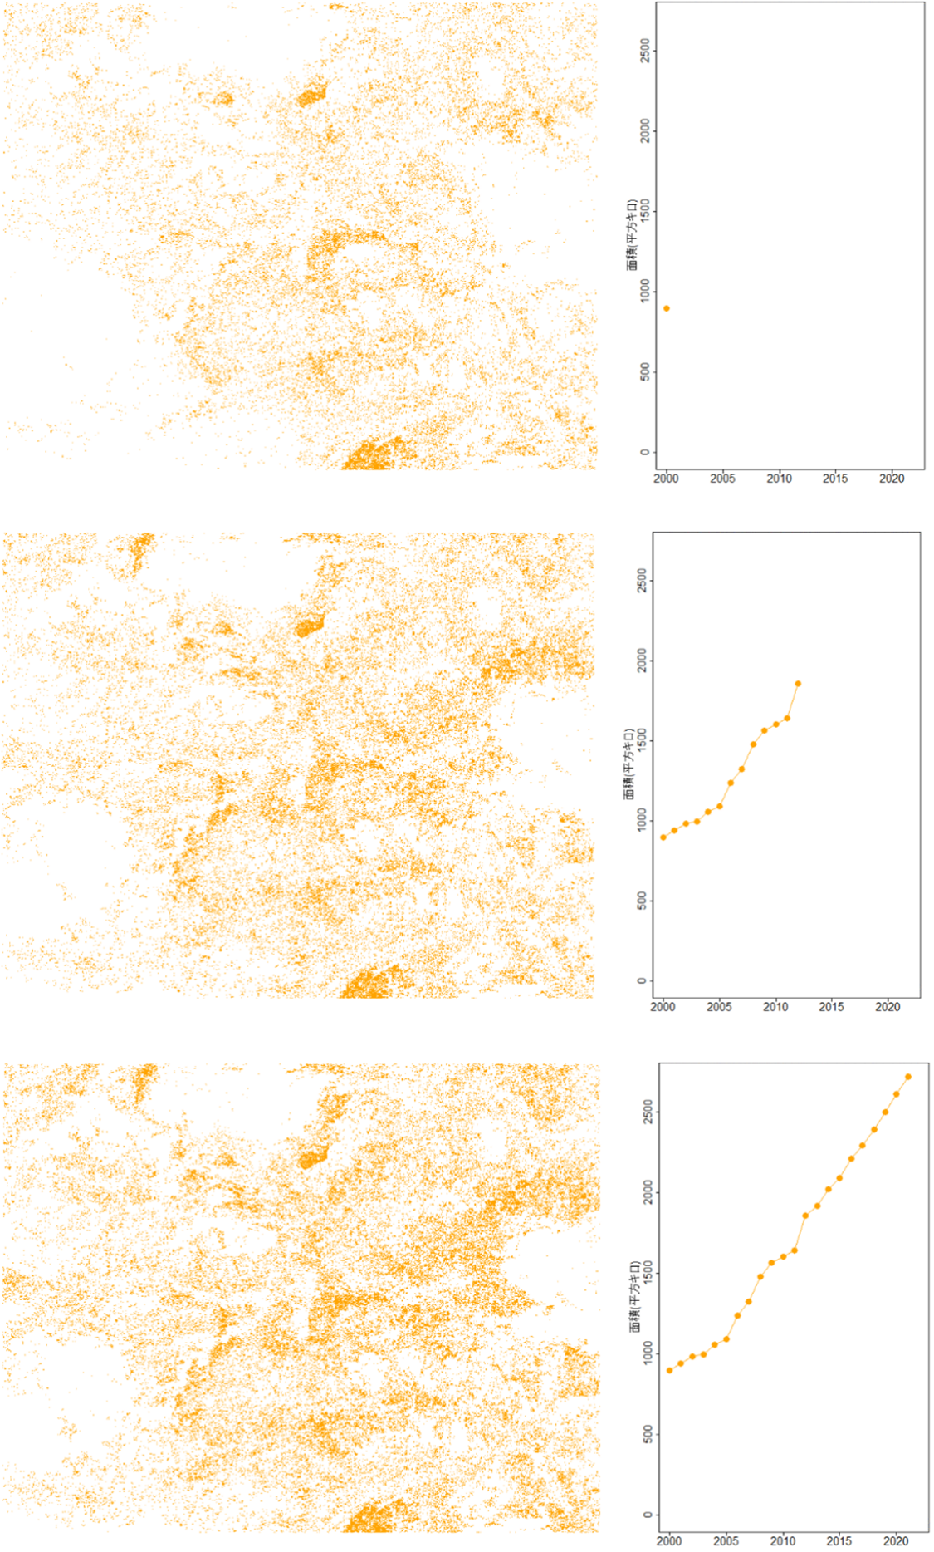
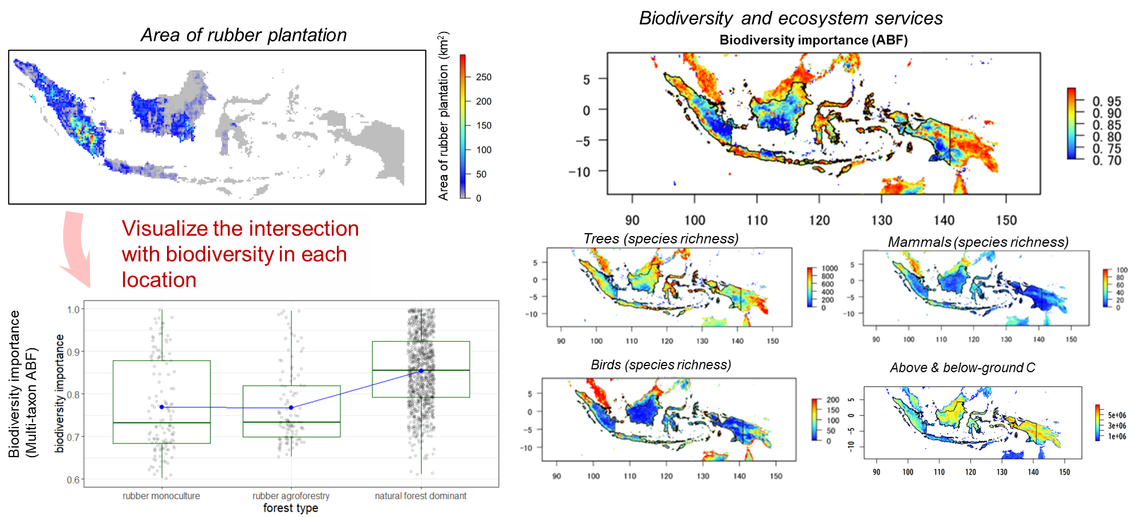
A factory site in Leipzig, Germany
Time-series change in vegetated area
Plant species richness map for adjacent area
Rubber plantations in Jambi, Indonesia
Change in area of
monoculture plantation
2000
2011
2021

Slide 7
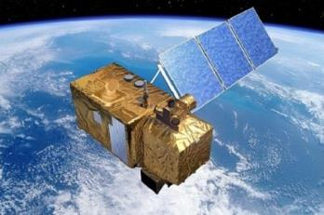
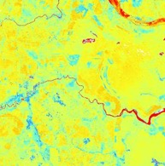
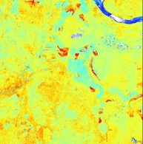
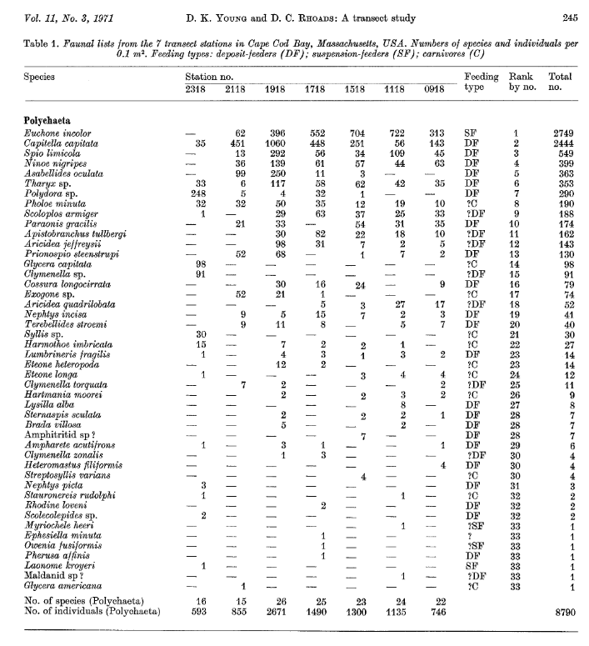
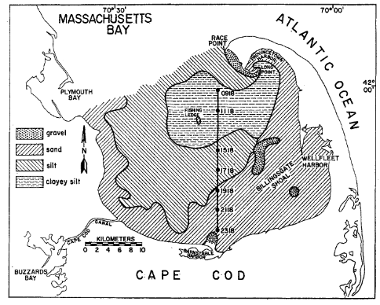
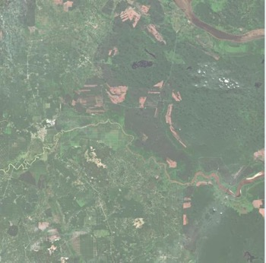
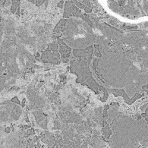
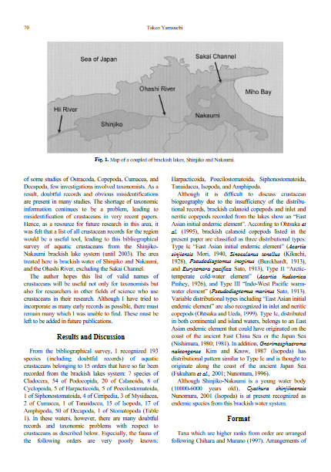
Ground-sensed biodiversity data
Calculate 239 indices using the multi-band image

Slide 8
Calculate 239 indices using the multi-band image
Ground-sensed biodiversity data

